Slide 1

Data Visualisation and Storytelling
Dimensionality
KC
09.2023
Notes:
##-AccessibilityAssistant: Skip layout check-##

Slide 2
This analysis could do with another hospital’s dataset
I need data!
More data!
Need some extra data!
MORE data!
MORE!
What if I link more registries?

Slide 3


So much data, it stopped making sense!
Notes:
##-AccessibilityAssistant: Skip layout check-##

Slide 4

Is my data really useful?

Slide 5
Curse of Dimensionality
As the number of features increases-
the data becomes increasingly sparse
computational complexity increases (exponentially)
overfitting increases
number of irrelevant features increases

Slide 6
Remember the exploratory data analysis!
Is the data very noisy?
Are the dimensions too big?
Make some pair plots, do the variables even have a relationship?
For time series data- Does every second matter?

Slide 7
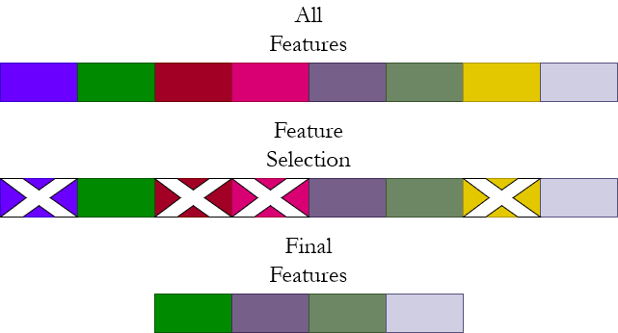
Dimensionality Reduction
Feature Selection
Select subset of relevant original features
Filters and clustering, wrapping and embedding

Slide 8
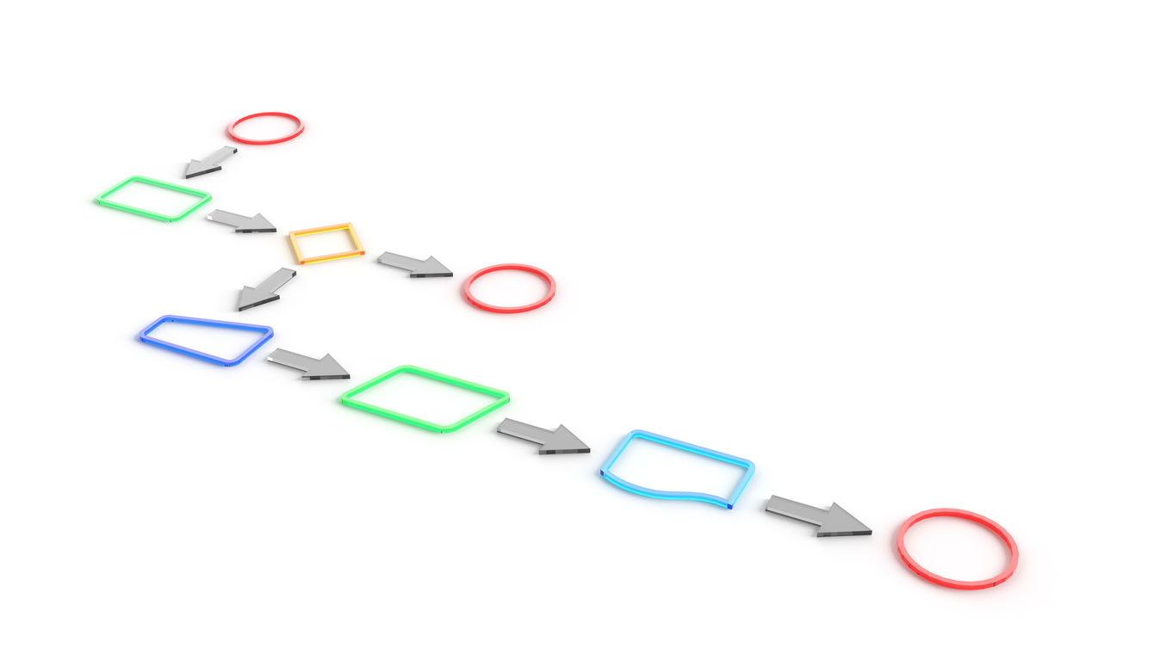
Dimensionality Reduction
Feature Extraction
Create new features by combining or transforming original features
Principal component analysis (PCA), linear discriminant analysis (LDA)
https://www.istockphoto.com/photo/simple-flow-chart-example-with-common-symbols-gm1256897191-368175306

Slide 9
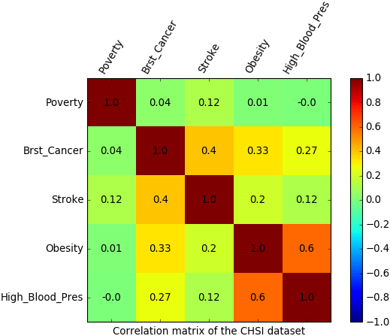
How to visualise feature relationships?
EDA techniques help- box plots, pair plots
Correlation matrix- How strong is the linear relationship between different variables?
Can help reduce features used
Can help reduce multicollinearity (independent variables having high correlation)
https://www.vertica.com/blog/in-database-machine-learning-2-calculate-a-correlation-matrix-a-data-exploration-post/

Slide 10
What do you observe?
Strong positive correlation between obesity and high BP
Moderate positive correlation between breast cancer and stroke, as well as breast cancer and obesity
No significant correlation between poverty and high blood pressure
https://www.vertica.com/blog/in-database-machine-learning-2-calculate-a-correlation-matrix-a-data-exploration-post/

Slide 11
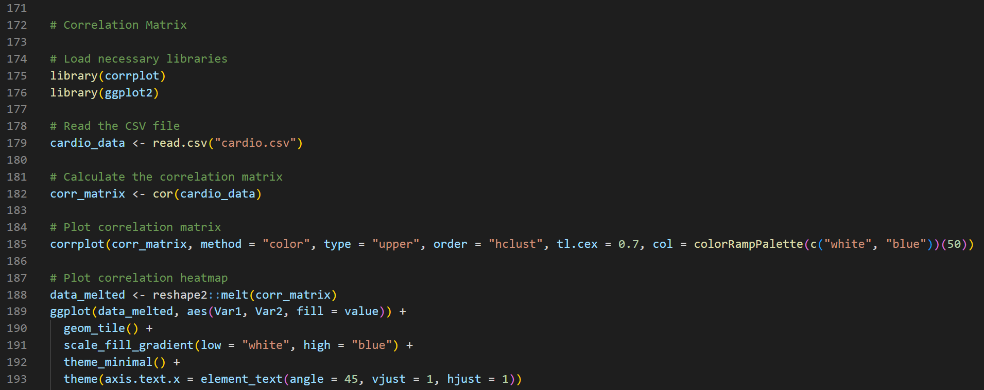
Quick R code for plotting correlation matrix

Slide 12
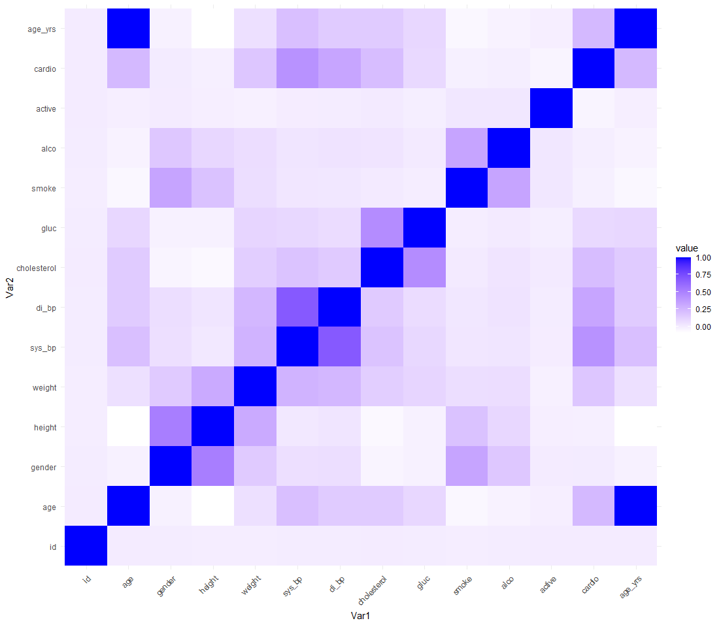
Quick R code for plotting correlation matrix

Slide 13
Principal Component Analysis
Dimensionality Reduction Method
Transform large set of variables into smaller one
Converts variables to principal components- linear combinations or mixtures of initial variables

Slide 14
Principal Component Analysis- Steps
1. Standardisation
PCA works only with continuous values.
Remove
NA values,
unnecessary columns,
mean and standard deviation from columns (z-score)

Slide 15
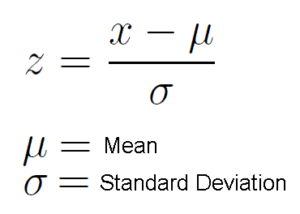
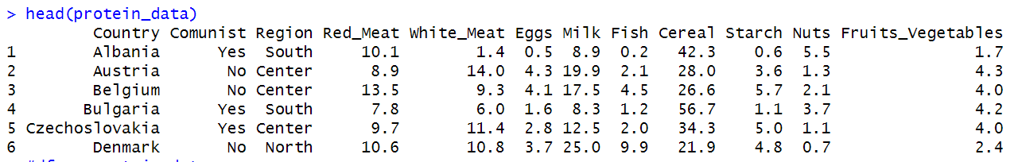
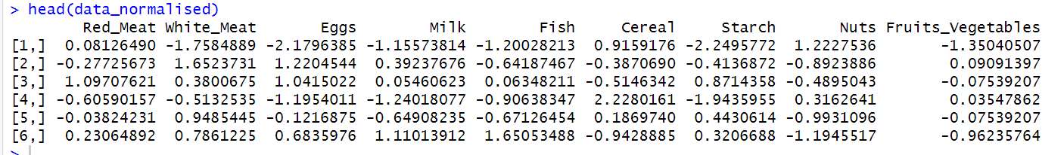
Step 1- Cleaning data
Remove NA Values

Slide 16
Principal Component Analysis- Steps
2. Plot covariance matrix
For each variable, principal components will be generated
Higher the absolute value of the component for each variable, higher is the significance of that variable

Slide 17
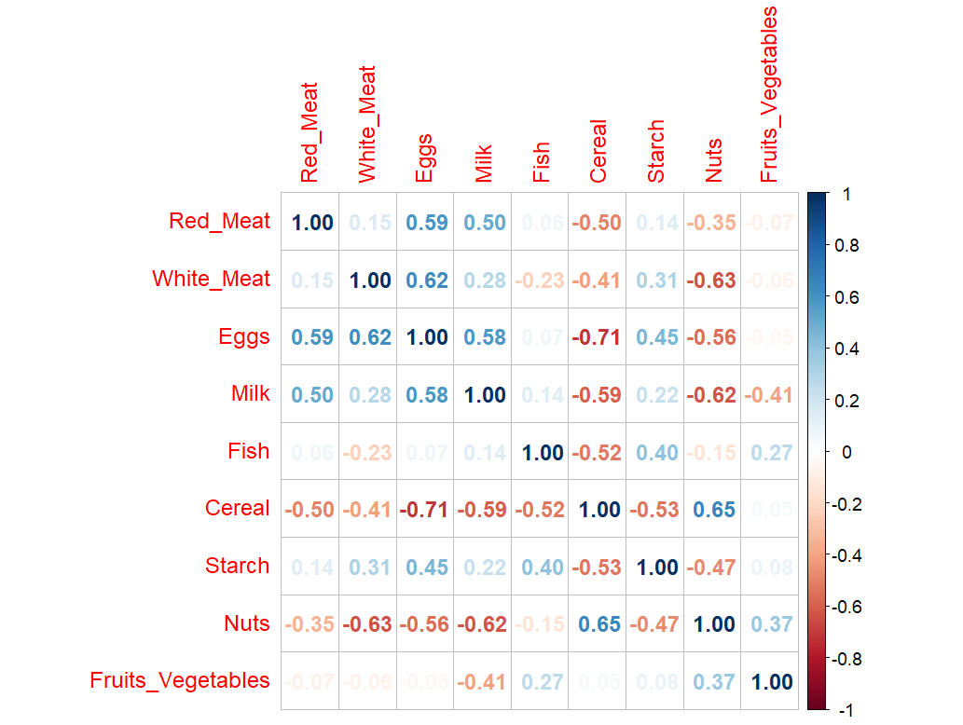
Step 2- Covariance Matrix

Slide 18
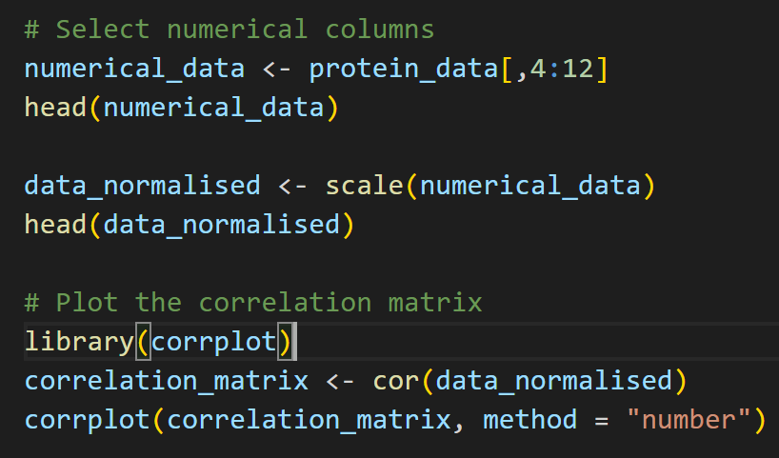
Some code

Slide 19
Principal Component Analysis- Steps
3. Apply PCA
Principal Components will be seen
Each component captures a certain proportion of variance in the data
Which variables make up components?

Slide 20
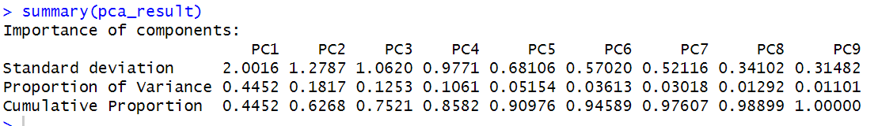
Step 2- Applying PCA
Each component captures a certain proportion of variance in the data
Why is this good?
It means you can use some variables instead of all, and still have similar representation in your data

Slide 21
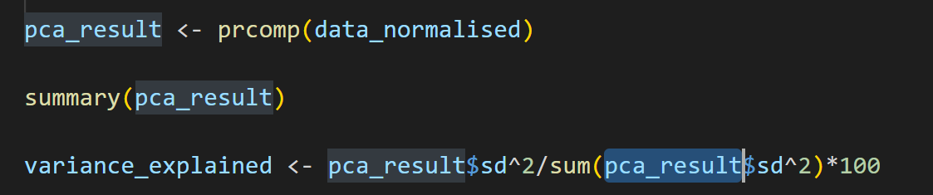
Some code
Notes:
Variance explained line: Not going in too much depth
You are taking the variance for each component/total variance
In other words- how much does each component contribute

Slide 22
Principal Component Analysis- Steps
3. Visualise PCA results
Elbow/Scree plots
BiPlots
Which components provide the highest variance?
Which variables make up components?

Slide 23
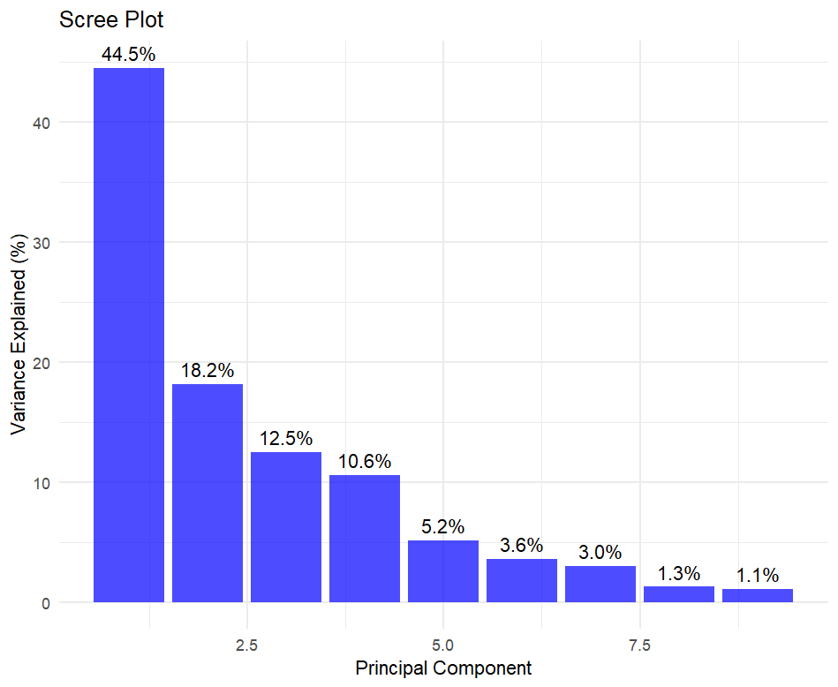
Step 3- Visualising PCA Results

Slide 24
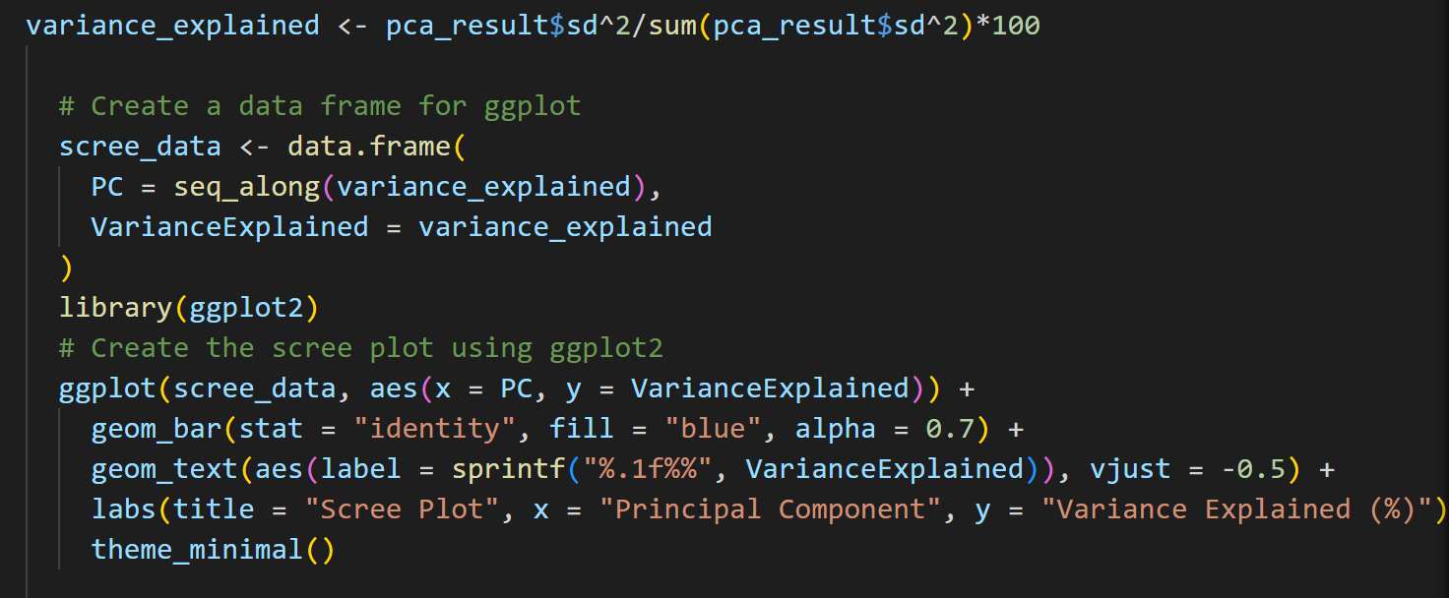
Some code
Notes:
Ggplot can give basic elbow (skree) plot

Slide 25
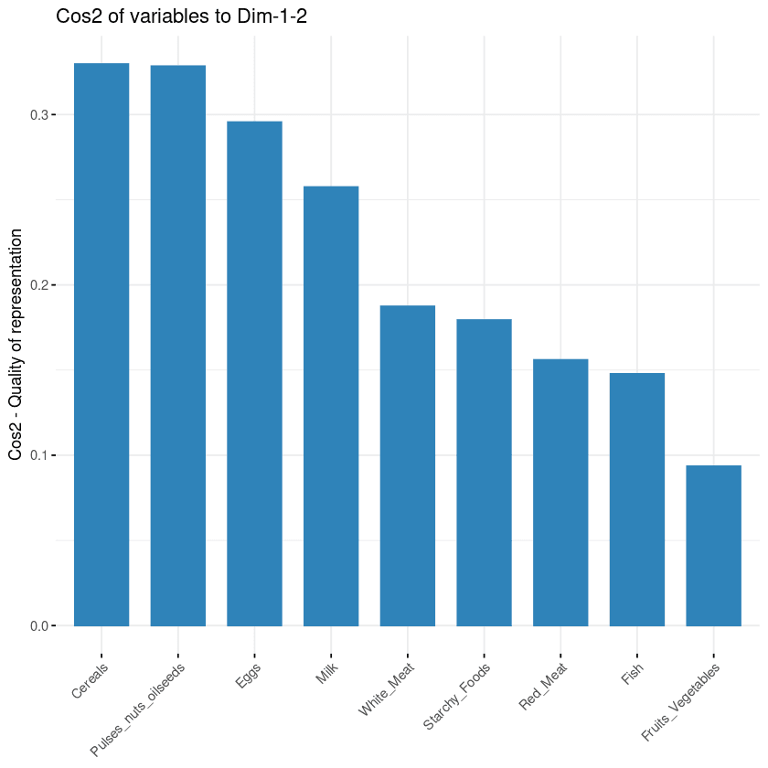
PCA Contribution of Variables to Components
Black magic!
Notes:
Squared cosine: Don’t need to remember why, just remember
cos squared is contribution of a component to the squared distance of the observation to the origin
You need a different library for this- will go through in practical session

Slide 26
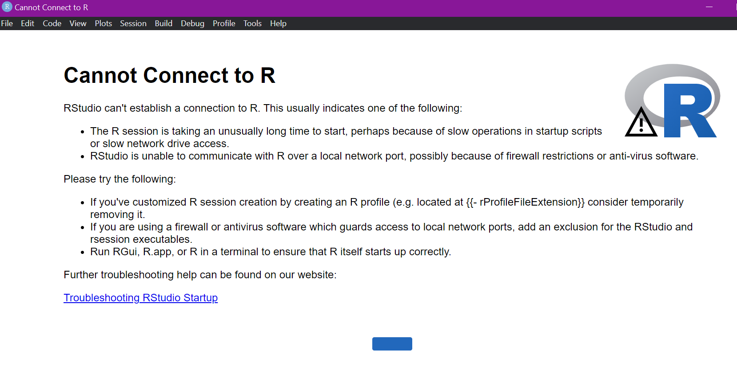
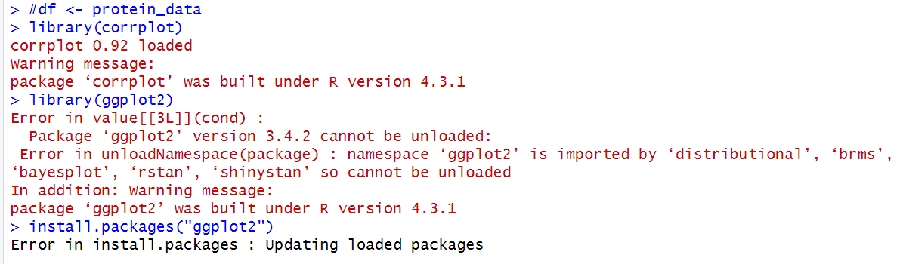
Quick R code for PCA

Slide 27
Clustering
Grouping similar data points together and discover underlying patterns
What is a cluster?
Collection of data points aggregated together because of certain similarities
How is it useful for EDA and PCA?
Visualise how your data is distributed
Scatter plots with additional steps

Slide 28
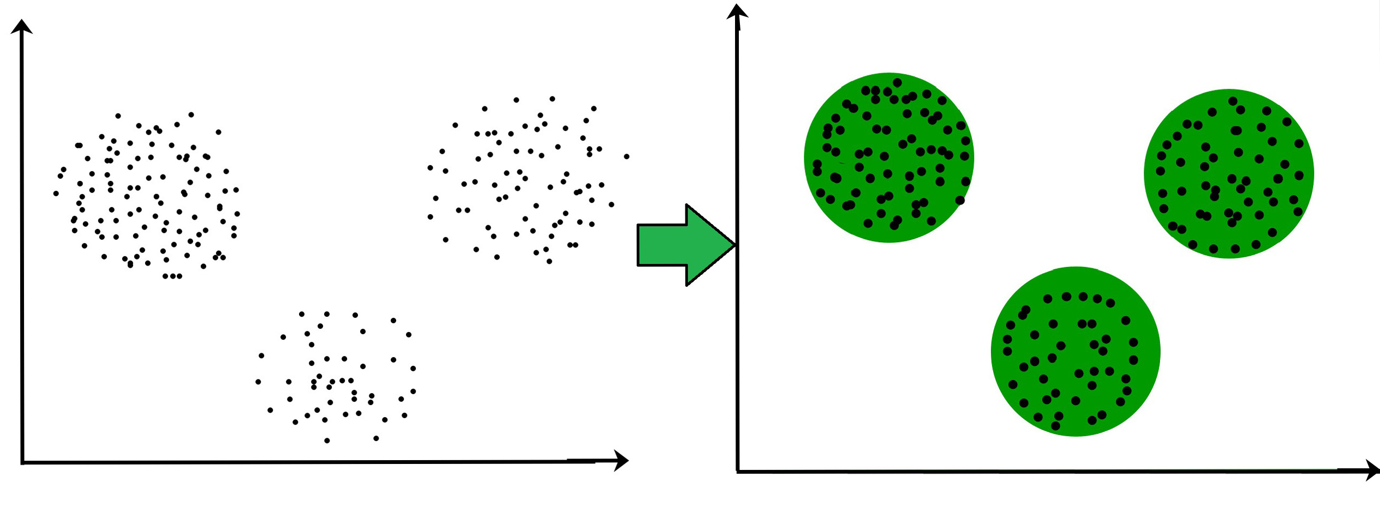
Clustering

Slide 29
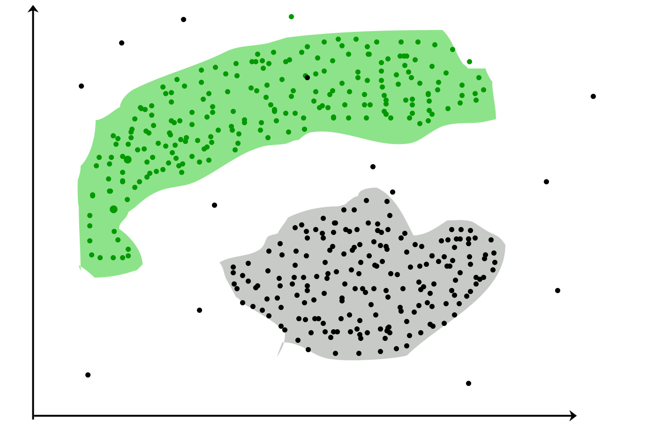
Clustering

Slide 30
Why is clustering relevant for me?
Medical diagnosis: Lets consider a medical dataset for diabetes with age, sex, bmi, HbA1C, family history, physical activity level, hypertension, fasting glucose levels
Can create 4 clusters for treatment plans
Cluster 1: Early Onset, High BMI, Sedentary Lifestyle
Cluster 2: Moderate Onset, Family History, Moderately Active
Cluster 3: Late Onset, Normal BMI, Highly Active
Cluster 4: Complicated Cases, High HbA1c, Co-morbidities
Notes:
Will go through code in practical session

Slide 31
Codes and Practical Session to Follow

